Slide 1

ANZ Transaction dataset
Exploratory Data Analysis
(Based on R)

Slide 2
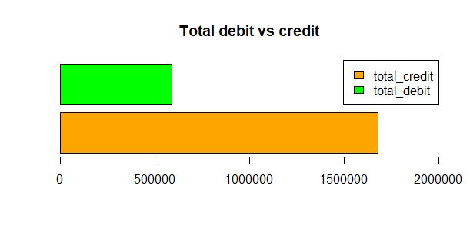
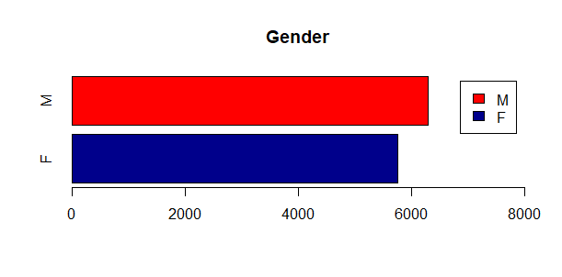
Basic insights on Gender & Transaction type
Transaction amount vs Gender and Transaction type
Inference: Males have higher amount of transactions (credit and debit) compared to females
Inference: Total for credit transactions is higher than total for debit transactions

Slide 3
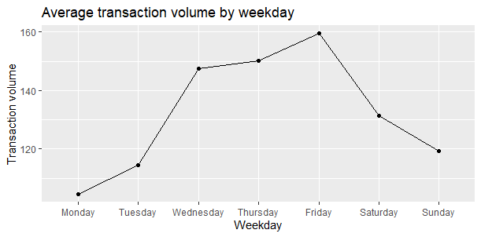
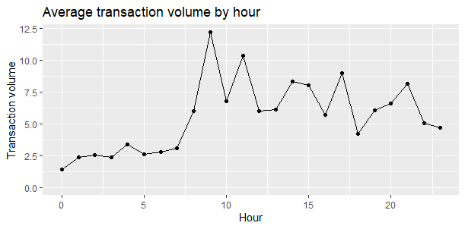
Weekly and hourly transaction frequency
Weekly/ hourly transaction frequency
Inference: Transaction amount increases every day peaking at Friday after which it falls over the weekend
Inference: Transaction amount varies across 24 hours with the highest being at hour 9 and lowest at hour 0

Slide 4
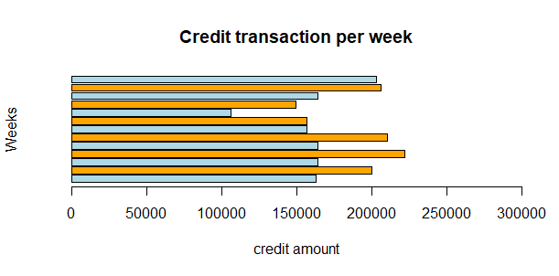
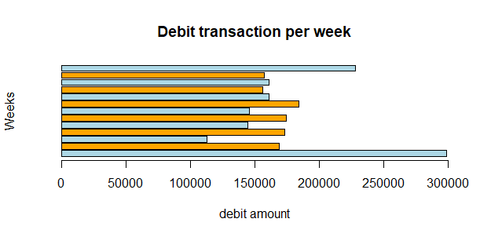
Dataset segmentation – Weekly transactions
Weekly average amount and frequency (credit & debit)
Week 13
Week 13
Week 12
Week 12
Week 11
Week 11
Week 10
Week 10
Week 9
Week 9
Week 8
Week 8
Week 7
Week 7
Week 6
Week 6
Week 5
Week 5
Week 4
Week 4
Week 3
Week 3
Week 2
Week 2
Week 1
Week 1
Inference: Higher credit does not directly translate to high debit transactions as we observe high debit weeks correlated with low credit weeks and vice versa. (Data should be normalized & correlated for further insight.)

Slide 5
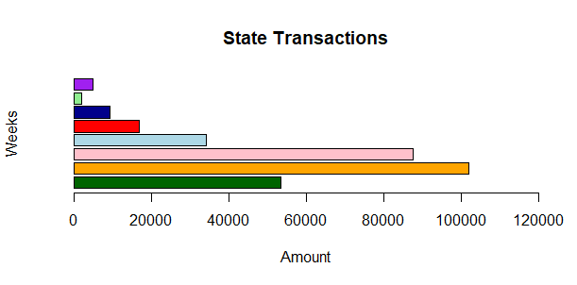
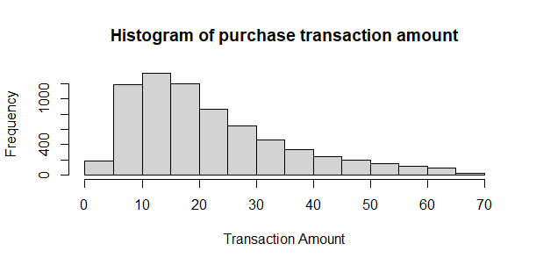
Transactions per state and purchase transaction amount frequency
Transaction amount vs Merchant state & Transaction frequency for purchases
ACT
TAS
NT
SA
WA
VIC
NSW
QLD
Inference: Highest transactions (credit & debit) in NSW followed by VIC and QLD. The lowest is in TAS
Inference: Purchase transaction frequency ranges from 0 to 70 with highest transaction frequency between the 10-20 range

